Slide 1
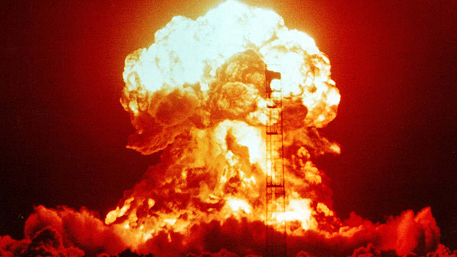
Discovery of Nuclear Fission
Molly Wakeling
Physics 290E Seminar
18 March 2020

Slide 2
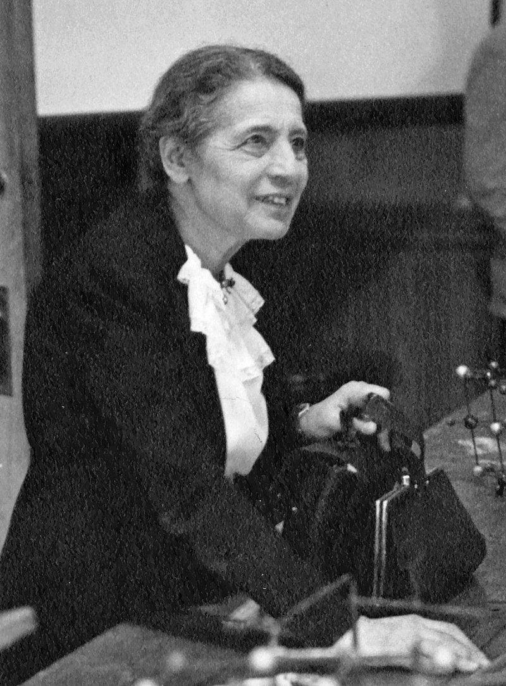
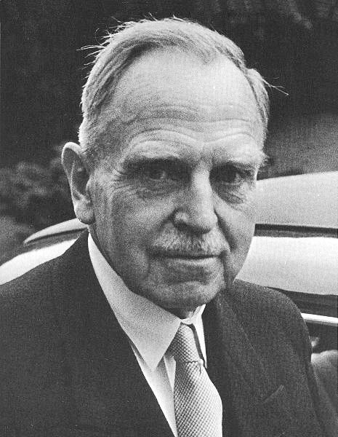
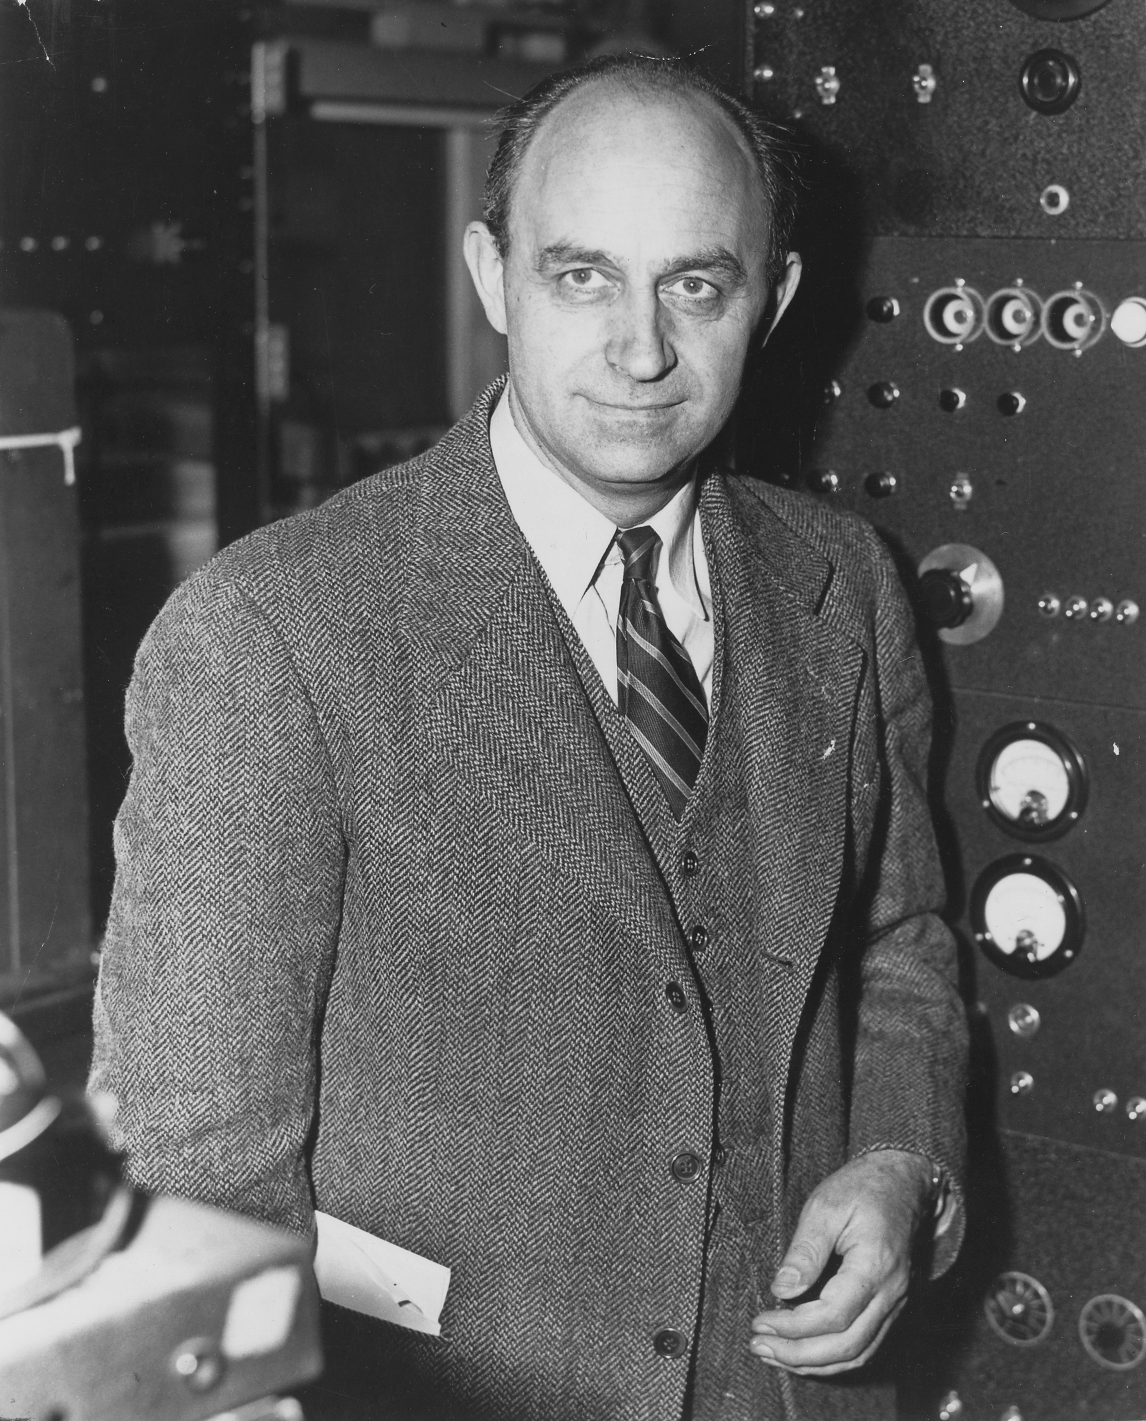
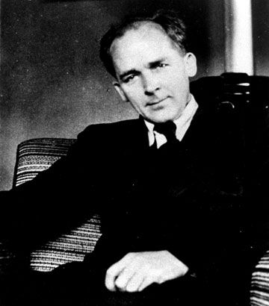
Cast of Characters
Lise Meitner
Otto Hahn
Enrico Fermi
Fritz Stassmann

Slide 3
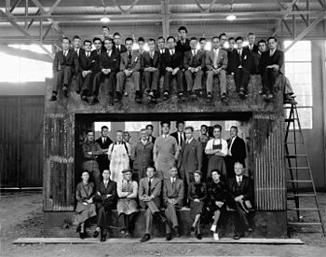
The Nuclear World in 1938
Radiation discovered in 1896
Alpha, beta, and gamma rays were ionized helium, electrons, and energetic light
Neutron discovered in 1932
Elements had different isotopes
1934: Fermi began bombarding uranium with neutrons, hoping to create heavier elements
Also in 1934, the Joliot-Curies bombarded lighter elements (lithium, aluminum) with protons and alphas to make radioactive isotopes of familiar elements
Lawrence’s Rad Lab at LBL bombarding all kinds of elements throughout the 1930s
Construction of the 60-inch cyclotron, 1938

Slide 4
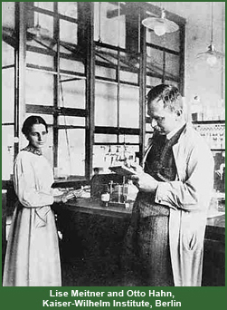
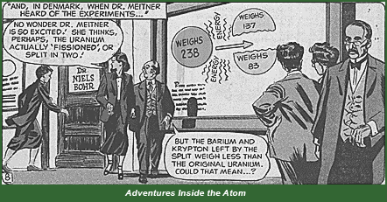
A Puzzling Observation
Meitner, Hahn, and Fritz Strassmann began bombarding uranium with neutrons and measuring the decay products
Meitner fled Germany in July 1938; continued correspondence with Hahn and Stassmann
Barium observed in decay products – how?
Expected neutrons to chip away at uranium – barium far too heavy
A Christmas idea from Meitner

Slide 5
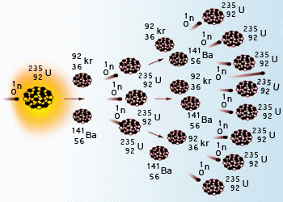
Chain Reaction
Determined that the fission process would produce additional neutrons, more fissions, and a lot of energy
Potential seen for power generation…and a bomb
Meitner: continued research work in nuclear reactors
Hahn: Won Nobel Prize in Chemistry in 1944 for the discovery of fission

Slide 6
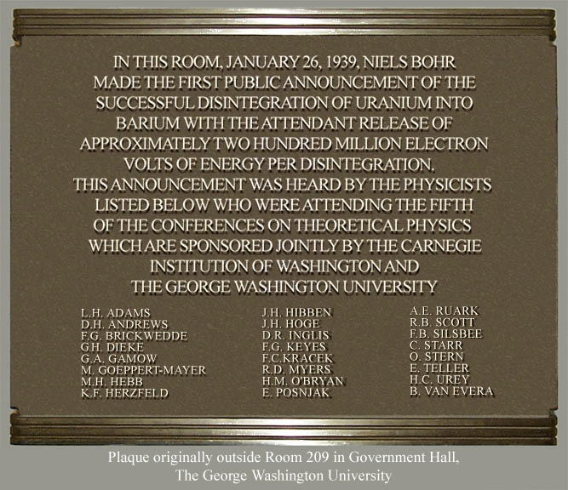
Fission in America
Bohr brought fission news to America, 1939
1940: John R. Dunning at Columbia and and Alfred Nier at University of Minnesota demonstrated that the fissioning isotope was U-235
Group photo at the 1939 Fifth Washington Conference on Theoretical Physics

Slide 7
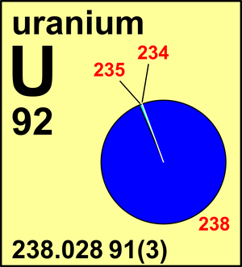
Nuclear Power
U-235 natural abundance: 0.72%
Fast vs slow neutrons
Rapid energy release = bomb potential

Slide 8
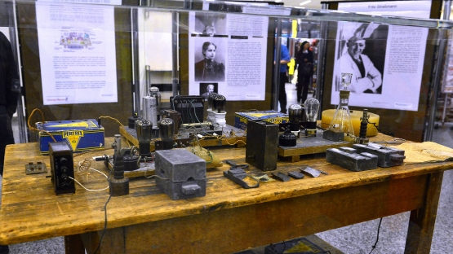
Measuring Fission
Hahn & Strassmann experimental setup:
Irradiation room
Chemistry lab
Measuring room

Slide 9
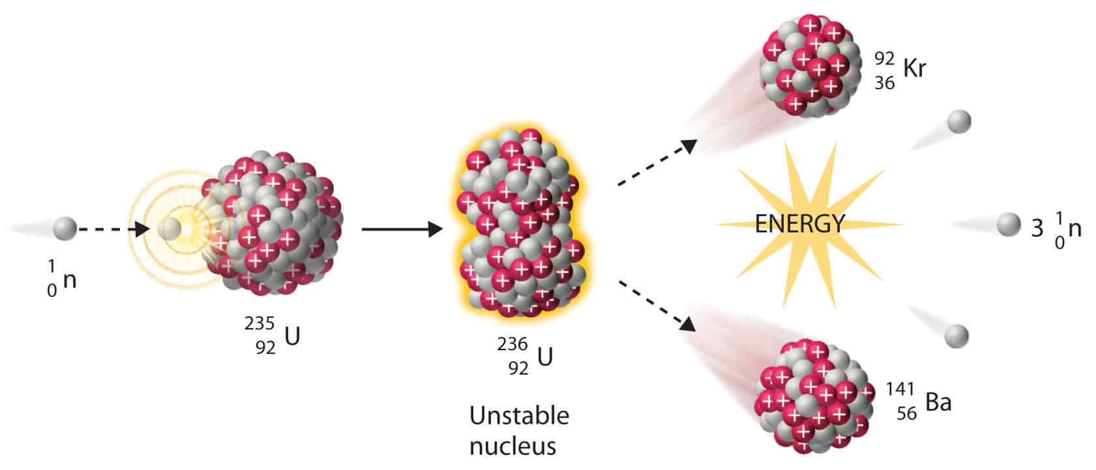
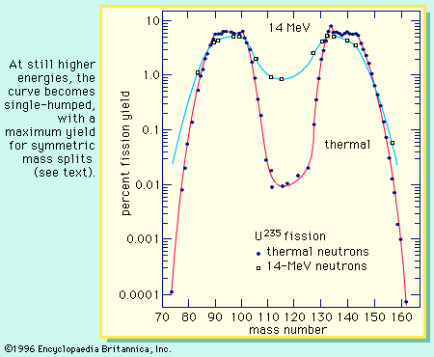
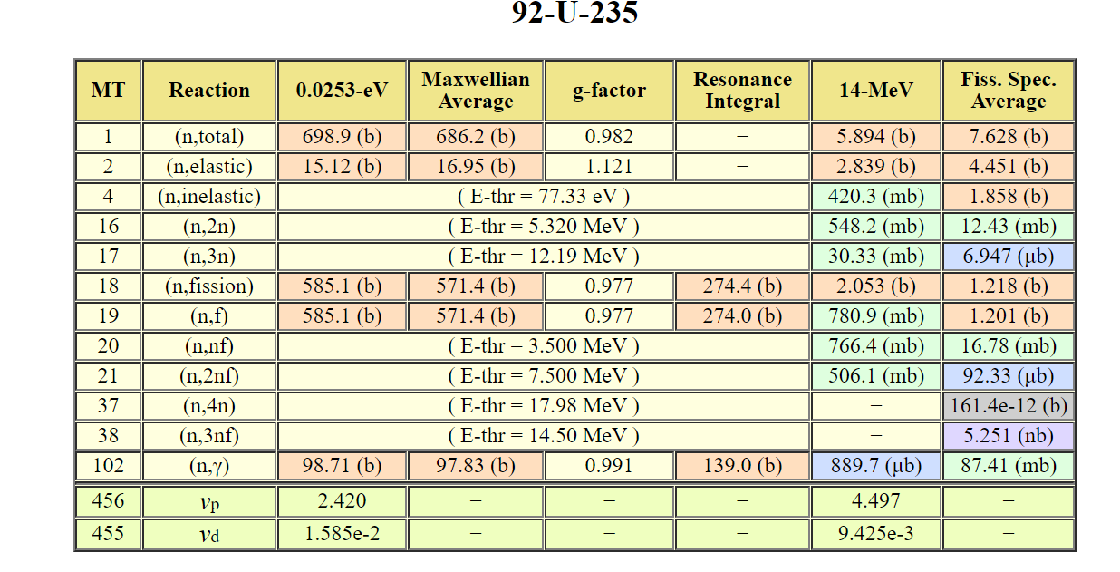
The Fission Reaction
Pretty straightforward:
n + ²³⁵U → ²³⁶U → fission fragments + neutrons + energy
Doesn’t break evenly in half: two humps centered on atomic masses 95 and 137
Neutron energy matters: cross section
Source: JAEA

Slide 10
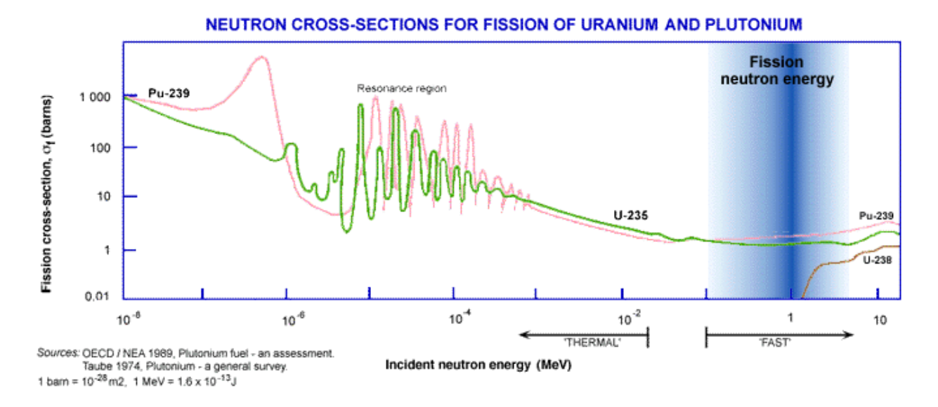

Slide 11
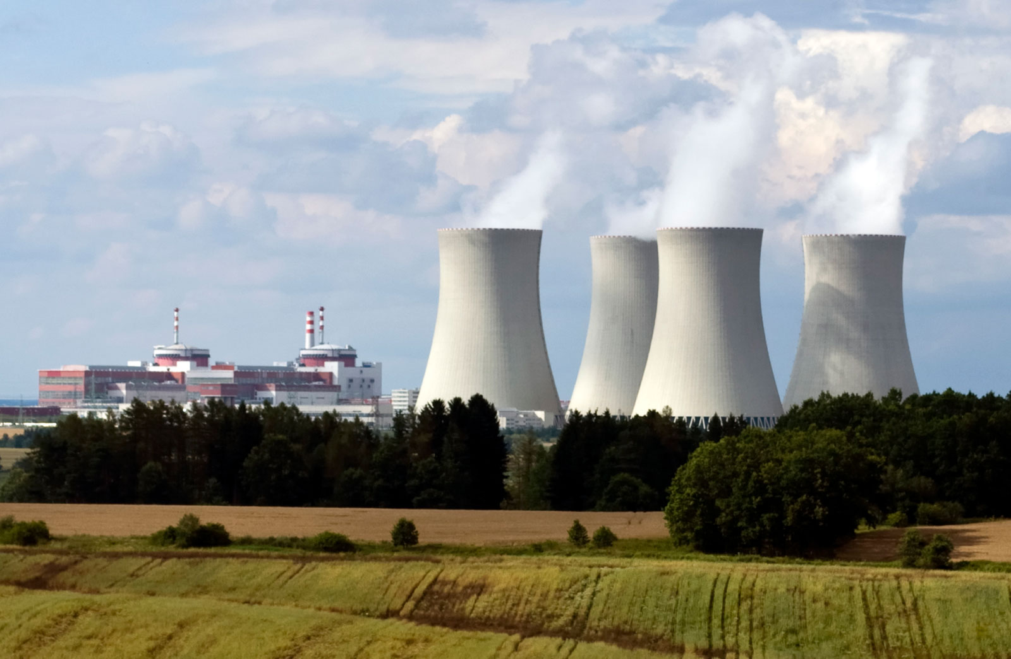
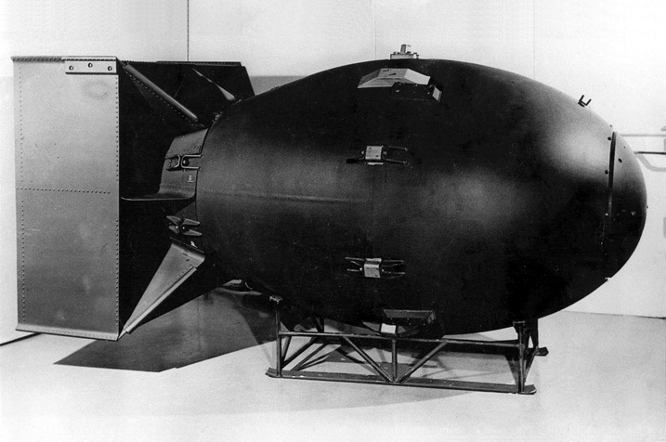
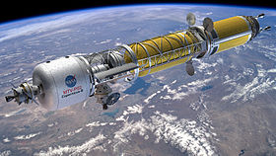
And the discovery led to…
Nuclear power:
14% of world’s electricity generation
75.2% in France
20% in the US
Atomic bomb
2 used in war, 1945
2,056 tested, among 8 countries (US, USSR, UK, France, China, India, Pakistan, North Korea)
Nuclear energy in space
Nuclear reactors on satellites have been tested
Future concepts: nuclear-powered ion thrusters, nuclear pulse propulsion

Slide 12
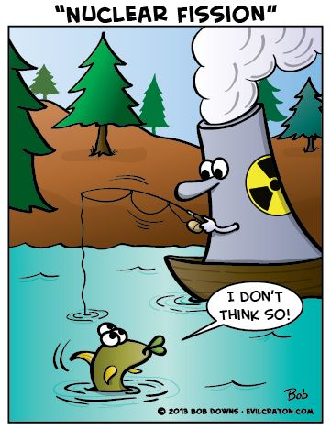
Questions?

