Slide 1
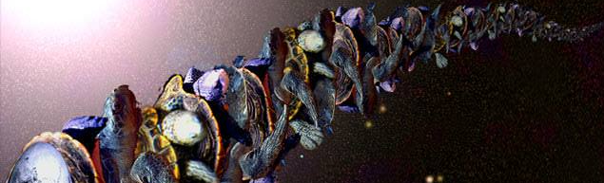
Graphs all the way down
Designing GNN architectures for particle tracking

Slide 2
Overview
PART I: GNNs for Particle Tracking
Short review of tracking problem
GNN solution
A taste of some GNN architectures
PART II: ML Pipeline and Architecture Design with Graphs
The GNN Sandbox: A place for fun and games
DVC + Weights & Biases: Reproducible hyperparameter optimisation
ArchiOpTrX: A GNN-based Neural Architecture Search

Slide 3
PART I: GNNs for particle tracking

Slide 4
New physics needs collisions…
Discovered
with collisions
Higgs boson (LHC),
Quarks (SLAC, Fermilab), and
Neutrino mass (Super-Kamiokande)
Supersymmetry,
Composite Higgs,
Dark matter,
Leptoquarks,
W/Z prime, and
Axions
Could be
discovered
with collisions

Slide 5
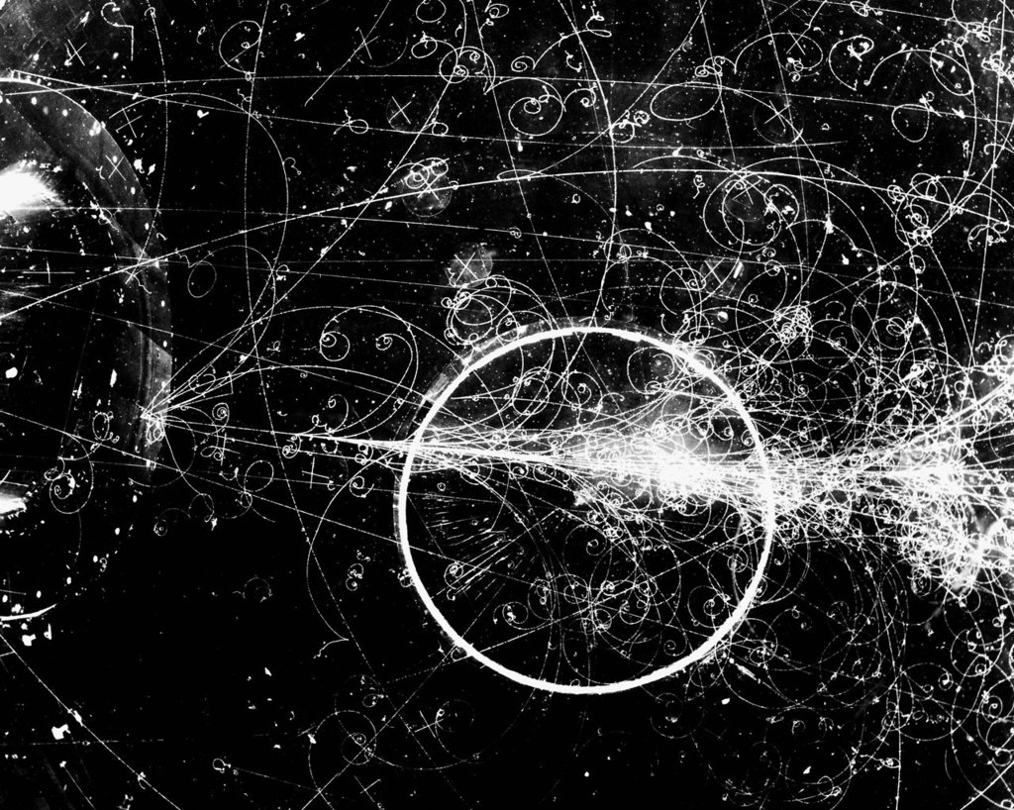
… but collisions are messy
… but collisions are messy
High energy collisions bring huge numbers of particles (unfortunately)
Want to see the particles coming out of the collisions, which we can get from the curves (“tracks”) moving through a magnetic field

Slide 6
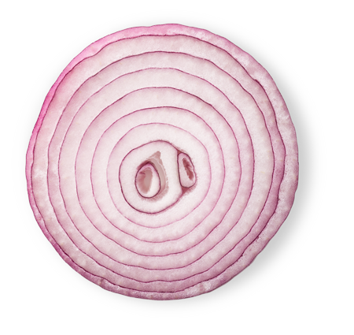
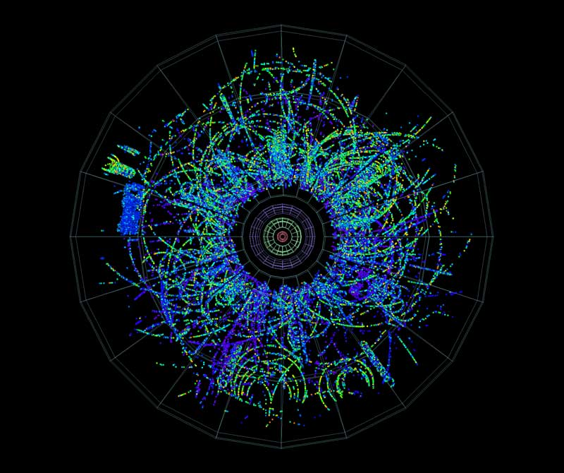
the “Tracking Problem” of new physics
New physics requires high energy and high precision
This implies carefully tracking millions of particles per event through the (as-few-as-possible) layers of a detector
Each collision comprises of dozens of events
Each second produces tens of millions of collisions

Slide 7
the “Tracking Problem” of new physics
New physics requires high energy and high precision
This implies carefully tracking millions of particles per event through the (as-few-as-possible) layers of a detector
Each collision comprises of dozens of events
Each second produces tens of millions of collisions

Slide 8
the “Tracking Problem” of new physics
New physics requires high energy and high precision
This implies carefully tracking millions of particles per event through the (as-few-as-possible) layers of a detector
Each collision comprises of dozens of events
Each second produces tens of millions of collisions
A particle interacting
with a layer is a “hit”

Slide 9
the “Tracking Problem” of new physics
We need a fast, high- accuracy method to connect hits into tracks to determine the types and energies of particles coming out of every event

Slide 10
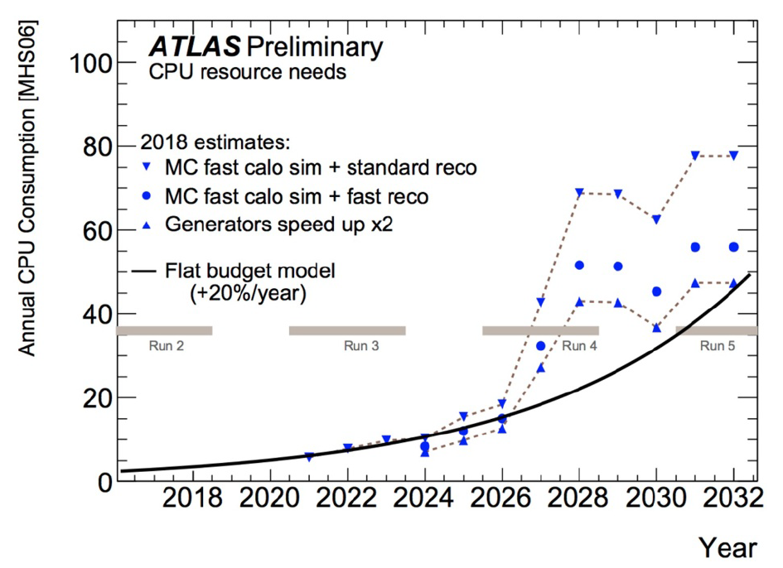
Current techniques will* not work on next-gen colliders
Standard doom-and-gloom plot
Traditional
methods
(scale quadratically)
2024 – 2026
14 TeV
6 Billion events/second
In other words…
Computing power
Predicted
capacity
*probably
Time, Energy, Number of Collisions

Slide 11
We want to build tracks
Observe hits on layers
Join hits into track
Convert track into particle information
(Dis)prove supersymmetry
This is our focus

Slide 12
Graphs are a natural way to represent tracks
We have a collection of hits
Want to “Connect the Dots” (the conference name for this problem)
A natural way is to represent the problem is as a graph

Slide 13
Tracks as graphs
Graph is a collection of nodes, connected by edges
Graph construction scales poorly, but is not the bottleneck – it is a simple combinatorial process
Graph prediction scales well – approximately as O(e) with number of edges e

Slide 14
Tracks as graphs
Graph is a collection of nodes, connected by edges
Graph construction scales poorly, but is not the bottleneck – it is a simple combinatorial process
Graph prediction scales well – approximately as O(e) with number of edges e

Slide 15
Tracks as graphs
Graph is a collection of nodes, connected by edges
Graph construction scales poorly, but is not the bottleneck – it is a simple combinatorial process
Graph prediction scales well – approximately as O(e) with number of edges e

Slide 16
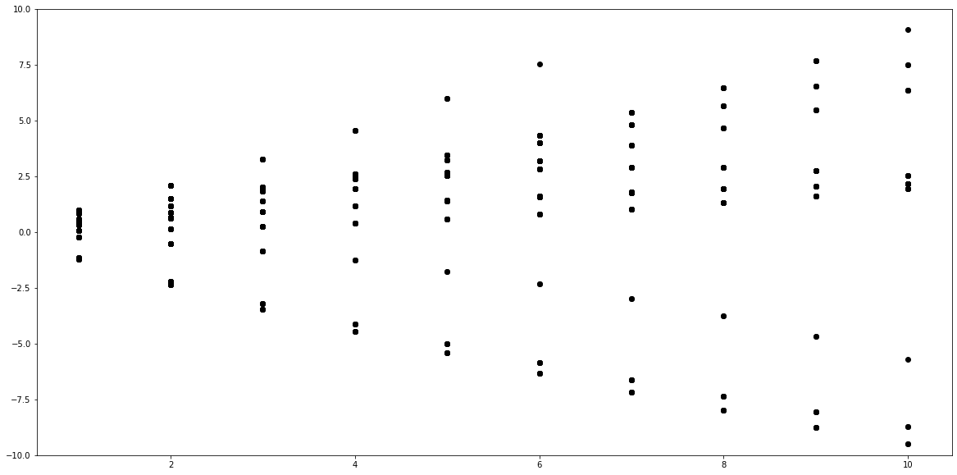
Graphs are a natural way to represent tracks
Some toy
data…
y direction
x direction

Slide 17
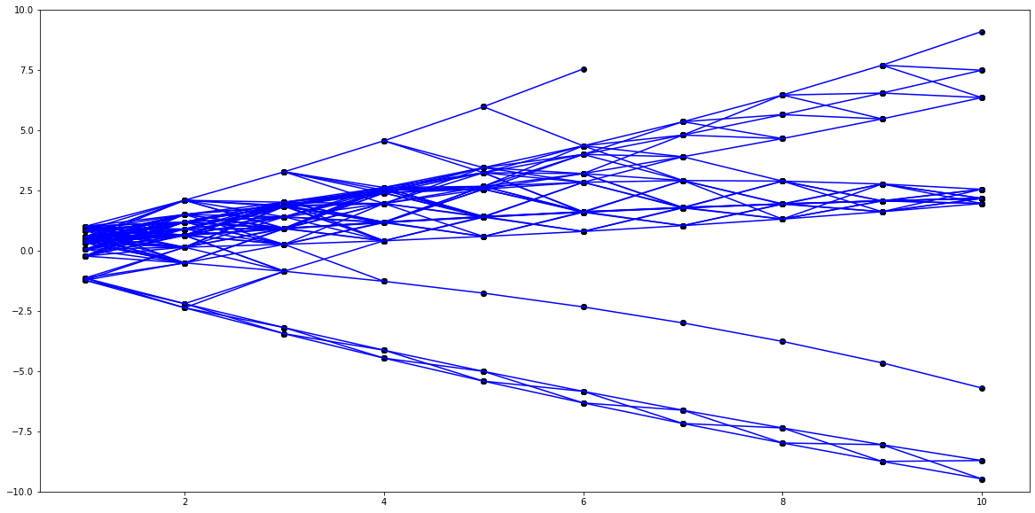
Graphs are a natural way to represent tracks
Join the
hits in some
clever/dumb
way…
y direction
x direction

Slide 18
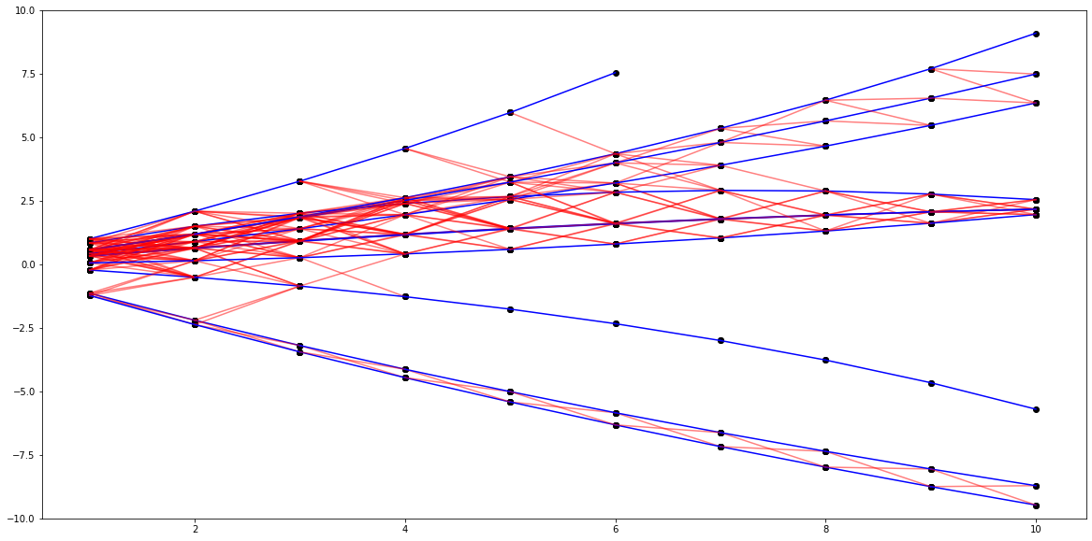
Graphs are a natural way to represent tracks
The tracks
should be
in here
y direction
x direction

Slide 19
Graph input FEATURES
Can attach low-level or high-level features to each node (i.e. hit)

Slide 20

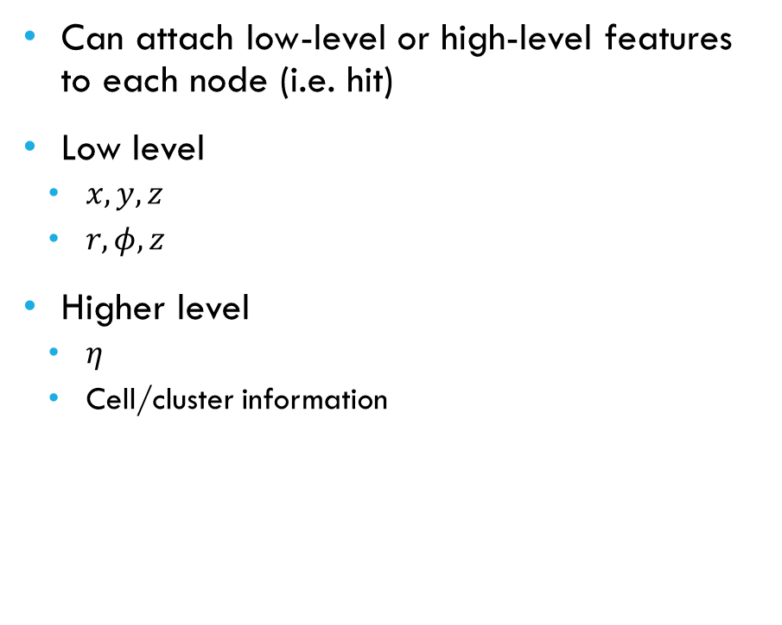
Graph input FEATURES
Can attach low-level or high-level features to each node (i.e. hit)
Low level
  $x, y, z$
  $r, φ, z$
Higher level
  $η$
  Cell/cluster information
$$x, y, z$$

Slide 21
Graph output FEATURES
0.9
0.2
0.1
Output depends on our question…
Output as edge feature – score of each edge being true
0.2
0.3
0.9
0.2
0.9

Slide 22




Graph output FEATURES
Output depends on our question…
Output as edge feature – score of each edge being true
Output as node feature – track parameters of a track associated to each hit
$$\{d_{3}, z_{3}, φ_{3},η_{3},\frac{q_{3}}{p_{3}}\}$$
$$\{d_{0}, z_{0}, φ_{0},η_{0},\frac{q_{0}}{p_{0}}\}$$
$$\{d_{1}, z_{1}, φ_{1},η_{1},\frac{q_{1}}{p_{1}}\}$$
$$\{d_{2}, z_{2}, φ_{2},η_{2},\frac{q_{2}}{p_{2}}\}$$

Slide 23
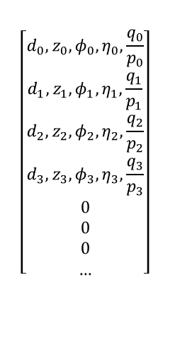
Graph output FEATURES
$$\left[\begin{aligned}d_{0}, z_{0}, φ_{0},η_{0},\frac{q_{0}}{p_{0}} \\ d_{1}, z_{1}, φ_{1},η_{1},\frac{q_{1}}{p_{1}} \\ d_{2}, z_{2}, φ_{2},η_{2},\frac{q_{2}}{p_{2}} \\ d_{3}, z_{3}, φ_{3},η_{3},\frac{q_{3}}{p_{3}} \\ 0 \\ 0 \\ 0 \\ …\end{aligned}\right]$$
Output depends on our question…
Output as edge features – score of each doublet being true
Output as node features – track parameters of a track associated to each hit
Output as graph features – padded prediction of n tracks and their parameters
Daniel Murnane LBNL ATLAS Annual Meeting January 7th, 2020

Slide 24

edge prediction architecture
Input node features
Hidden node features
Hidden edge features
Edge score
Attention aggregation
New hidden node features
New hidden edge features
New edge score
$${\left(\begin{aligned}x \\ y \\ z\end{aligned}\right)}_{0}$$
x n iterations
(hyperparameter)

Slide 25

edge prediction architecture
Input node features
Hidden node features
Hidden edge features
Edge score
Attention aggregation
New hidden node features
New hidden edge features
New edge score
$${\left(\begin{aligned}x \\ y \\ z\end{aligned}\right)}_{0}$$
$${\left(\begin{aligned}h_{1} \\ … \\ h_{n}\end{aligned}\right)}_{0}$$
x n iterations

Slide 26


edge prediction architecture
$${\left(\begin{aligned}h_{1} \\ … \\ h_{n}\end{aligned}\right)}_{1}$$
Input node features
Hidden node features
Hidden edge features
Edge score
Attention aggregation
New hidden node features
New hidden edge features
New edge score
$${\left(\begin{aligned}h_{1} \\ … \\ h_{n}\end{aligned}\right)}_{0,1}$$
$${\left(\begin{aligned}h_{1} \\ … \\ h_{n}\end{aligned}\right)}_{0}$$
x n iterations

Slide 27
edge prediction architecture
Input node features
Hidden node features
Hidden edge features
Edge score
Attention aggregation
New hidden node features
New hidden edge features
New edge score
$${\left(\begin{aligned}h_{1} \\ … \\ h_{n}\end{aligned}\right)}_{0,1}$$
0.6
x n iterations

Slide 28
edge prediction architecture
Input node features
Hidden node features
Hidden edge features
Edge score
Attention aggregation
New hidden node features
New hidden edge features
New edge score
0.6
0.4
0.1
x n iterations
0.4
0.1
0.8
0.8
0.9

Slide 29





edge prediction architecture
Input node features
Hidden node features
Hidden edge features
Edge score
Attention aggregation
New hidden node features
New hidden edge features
New edge score
$${\vec{h}}_{1}$$
$${\vec{h}}_{2}$$
0.6
0.4
x n iterations
0.4
0.1
0.8
$${\vec{h}}_{3}$$
$${\vec{h}}_{4}$$
$${\vec{h}}_{5}$$

Slide 30






edge prediction architecture
Input node features
Hidden node features
Hidden edge features
Edge score
Attention aggregation
New hidden node features
New hidden edge features
New edge score
0.6
0.4
$${\left(\begin{aligned}h_{1} \\ … \\ h_{n}\end{aligned}\right)}_{0}$$
$${\vec{h}}_{1}$$
$${\vec{h}}_{2}$$
+
$${\vec{h}}_{5}$$
$${\vec{h}}_{3}$$
$${\vec{h}}_{4}$$
x n iterations
0.4
0.1
0.8

Slide 31
edge prediction architecture
$${\left(\begin{aligned}h_{1} \\ … \\ h_{n}\end{aligned}\right)}_{1}$$
Input node features
Hidden node features
Hidden edge features
Edge score
Attention aggregation
New hidden node features
New hidden edge features
New edge score
$${\left(\begin{aligned}h_{1} \\ … \\ h_{n}\end{aligned}\right)}_{0,1}$$
0.6
$${\left(\begin{aligned}h_{1} \\ … \\ h_{n}\end{aligned}\right)}_{0}$$
x n iterations

Slide 32
edge prediction architecture
Input node features
Hidden node features
Hidden edge features
Edge score
Attention aggregation
New hidden node features
New hidden edge features
New edge score
0.9
0.2
0.1
$${\left(\begin{aligned}h_{1} \\ … \\ h_{n}\end{aligned}\right)}_{0,1}$$
x n iterations
x n iterations
(hyperparameter)
0.2
0.3
0.9
0.2
0.9

Slide 33
Edge prediction performance
Tuning hyperparameters (e.g. n iterations)
Mention sandbox with W&B link
Daniel Murnane LBNL ATLAS Annual Meeting January 7th, 2020

Slide 34
Edge prediction performance
Tuning hyperparameters (e.g. n iterations)
Mention sandbox with W&B link
Daniel Murnane LBNL ATLAS Annual Meeting January 7th, 2020

Slide 35
Edge prediction performance
Tuning hyperparameters (e.g. n iterations)
Mention sandbox with W&B link
Daniel Murnane LBNL ATLAS Annual Meeting January 7th, 2020

Slide 36
Edge prediction performance
Tuning hyperparameters (e.g. n iterations)
Mention sandbox with W&B link
Daniel Murnane LBNL ATLAS Annual Meeting January 7th, 2020

Slide 37
Edge prediction performance
Tuning hyperparameters (e.g. n iterations)
Mention sandbox with W&B link
Daniel Murnane LBNL ATLAS Annual Meeting January 7th, 2020

Slide 38
Edge prediction performance
Tuning hyperparameters (e.g. n iterations)
Mention sandbox with W&B link
Daniel Murnane LBNL ATLAS Annual Meeting January 7th, 2020

Slide 39
Edge prediction performance
Tuning hyperparameters (e.g. n iterations)
Mention sandbox with W&B link
Daniel Murnane LBNL ATLAS Annual Meeting January 7th, 2020

Slide 40
Edge prediction performance
Choose
threshold
for true
edges
Tuning hyperparameters (e.g. n iterations)
Mention sandbox with W&B link
e.g. 0.5
Daniel Murnane LBNL ATLAS Annual Meeting January 7th, 2020

Slide 41
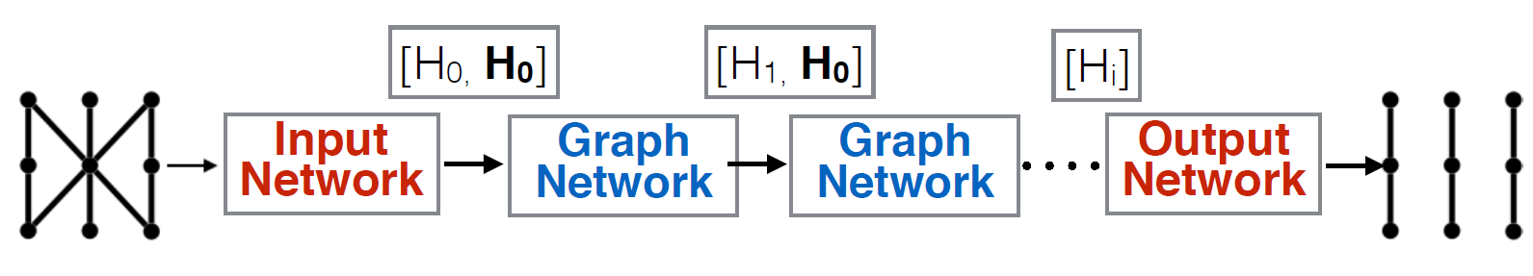
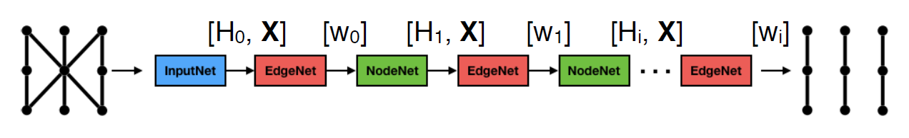

edge prediction architecture
Message Passing
Attention Message Passing
Attention Message Passing with Recursion

Slide 42
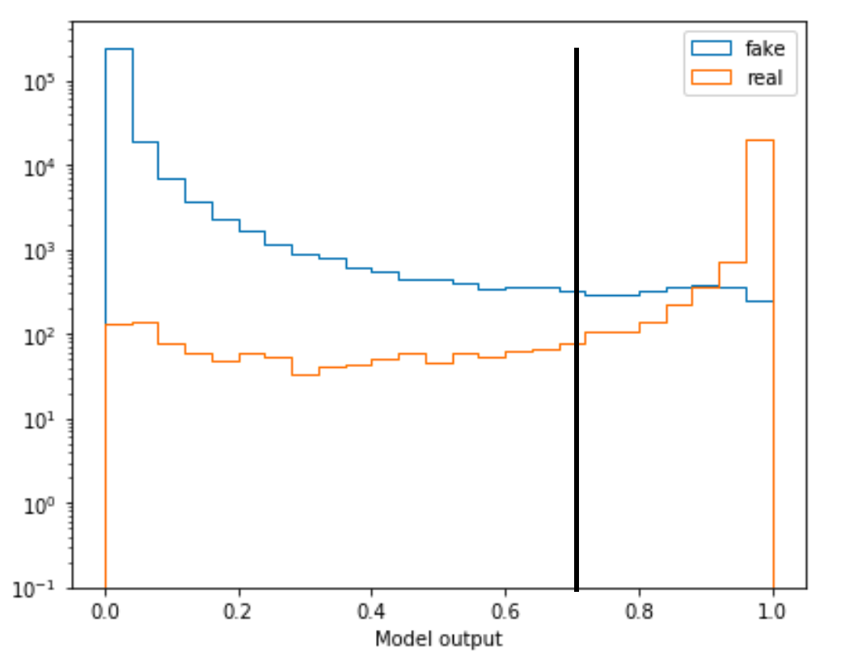
edge prediction performance
Recursive attention GNN
~ 43k parameters in Pytorch
Trained on NVIDIA V100 GPU for ~ 60 epochs
Binary logit loss function
With “truth” cut-off of 0.7
  Edge efficiency: 95.2%
  Edge purity: 90.2%

Slide 43
From Doublets to Triplets…

Slide 44
Why not simply join together our doublet predictions?
x₄
x₃
0.01
0.99
Pretty easy
decision
Distance from detector centre
x₂
0.99
x₁

Slide 45
Doublet choice can be ambiguous
x₄
x₃
0.87
0.84
Not so easy…
so teach the network
how to combine
Distance from detector centre
x₂
0.99
x₁

Slide 46
But a GNN doesn’t know about “triplets”
x₄
x₃
A GNN only knows
about nodes
and edge
Distance from detector centre
x₂
?
?
x₁

Slide 47
Moving to a “doublet graph” gives us back GNN power
x₄
x₃
0.87
0.84
x₂
x₂
x₂
Now…
nodes represent doublets,
edges represent triplets
0.99
x₁

Slide 48
Moving to a “doublet graph” gives us back GNN power
( )
( )
x₂
x₂
x₄
x₃
0.87
0.84
( )
x₁
x₂
0.99
Now…
nodes represent doublets,
edges represent triplets

Slide 49
The triplet classifier runs with all the benefits of the doublet classifier
Aim is to beat all traditional methods of finding true triplets
Can then either continue to 4, 5, …-plets in order to create and end-to-end GNN track builder…
…or hand off the triplets as seeds to the traditional techniques, knowing we can be confident in their accuracy

Slide 50
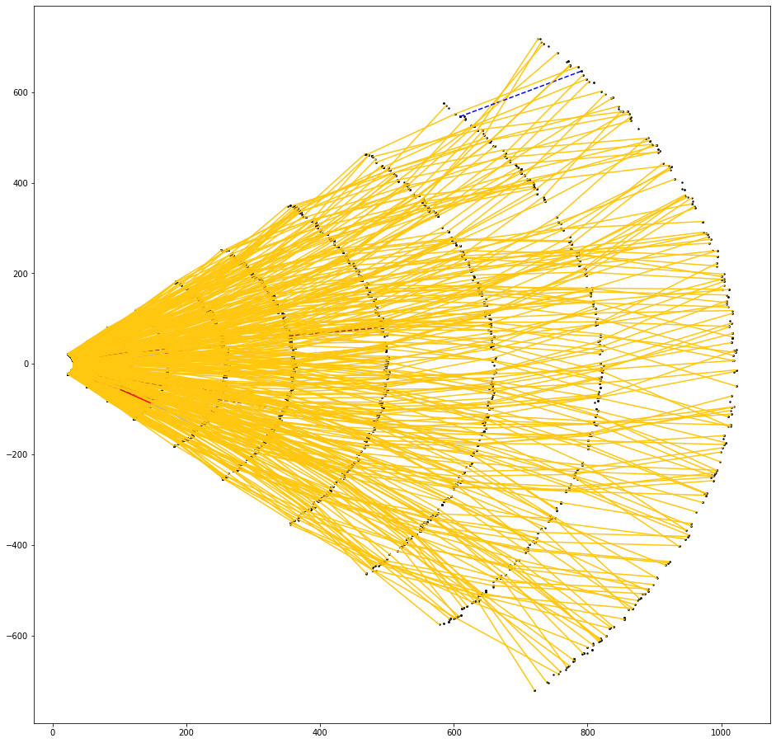
Triplet GNN performs very well
Gold: Unambiguously correct triplet or quadruplet
Other colours: False positive/negative
Key:
Silver: Ambiguously correct triplet or quadruplet (i.e. edge shared by correct triplet and false positive triplet)
Bronze dashed: Correct triplet, but missed quadruplet (i.e. edge shared by correct triplet and false negative triplet)
Red: Completely false positive triplet
Blue dashed: Completely false negative triplet

Slide 51
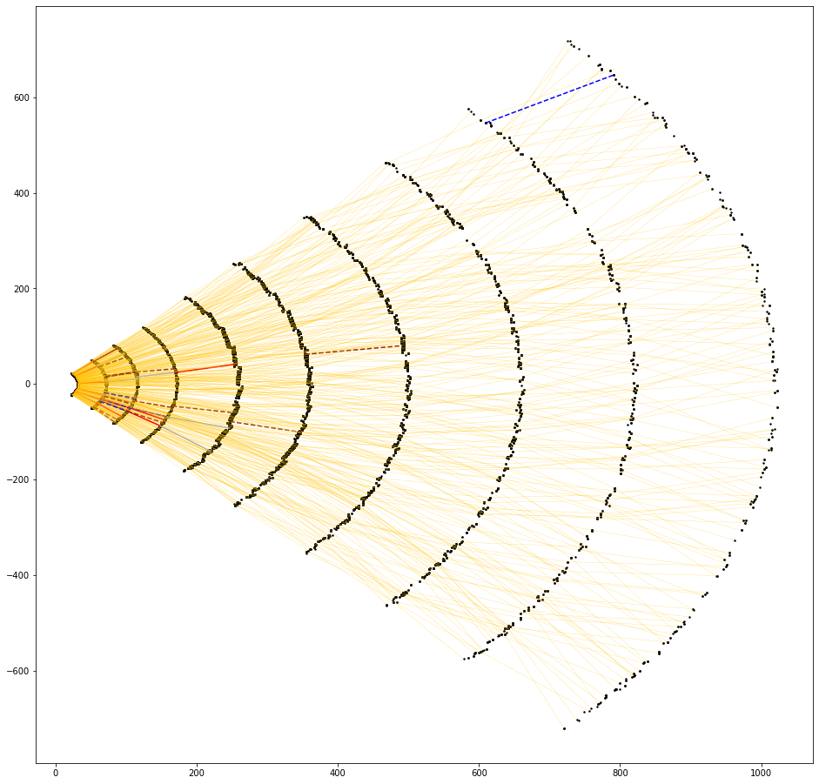
Triplet GNN performs very well
Gold: Unambiguously correct triplet or quadruplet
Other colours: False positive/negative
Key:
Silver: Ambiguously correct triplet or quadruplet (i.e. edge shared by correct triplet and false positive triplet)
Bronze dashed: Correct triplet, but missed quadruplet (i.e. edge shared by correct triplet and false negative triplet)
Red: Completely false positive triplet
Blue dashed: Completely false negative triplet

Slide 52
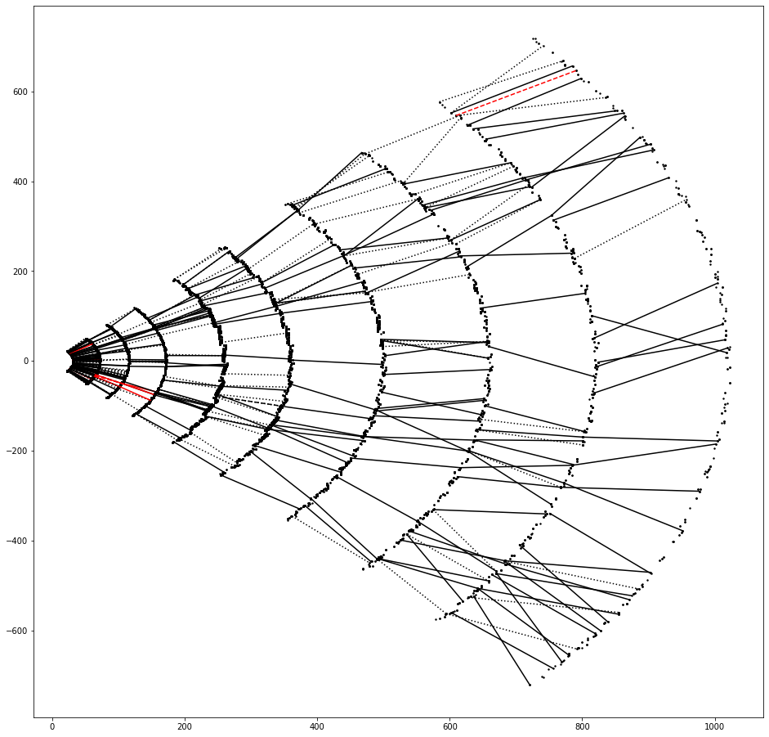
Triplet GNN improves doublet GNN results
Black: Triplet classifier correctly labelled, doublet classifier mislabelled
Red: Doublet classifier correctly labelled, triplet classifier mislabelled
In this graph, triplet classifier
Fixes 389 edges
Worsens 10 edges

Slide 53
PART II: ML pipeline and architecture design with graphs

Slide 54
GNN Sandbox
Problem statement: There are many possible input/output node/edge/graph features, there are many GNN architectures each working on different types of features, each architecture needs HPO to understand its strength/weakness
Would like to create a GNN sandbox – a pipeline that is modular and reproducible that can both manually and automatically
  Generate toy data / Load toy data
  Generate a full GNN architecture
  Train and evaluate the architecture
  Optimise the hyperparameters
  Compare between other architectures
  Keep track of the hyperparameters, model architecture, weights, metrics, performance, input/output data, … everything, so that any of these can be tweaked or optimised further with no extra coding/work

Slide 55
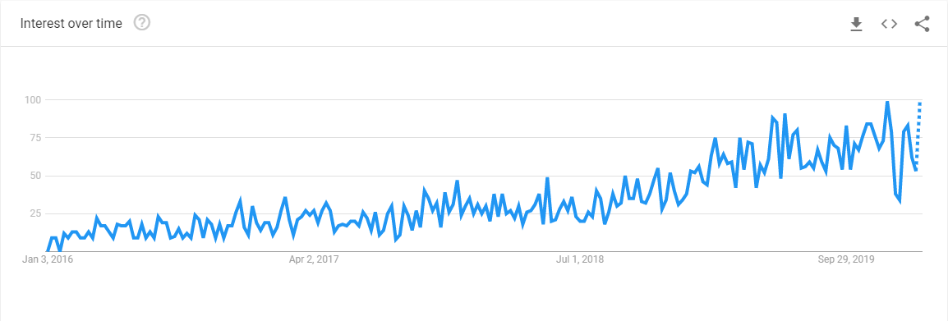
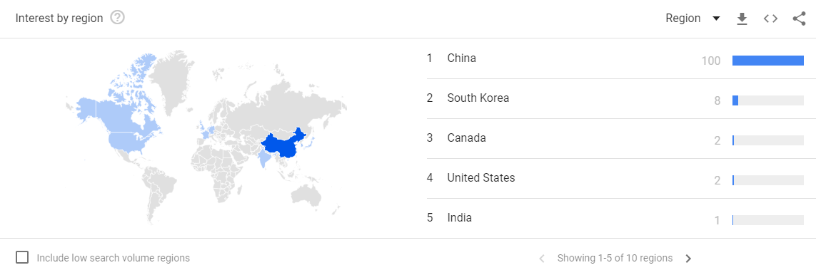
Too many GNNs to code by hand
In 2019, approx. 1 GNN paper every two days
Presumably will increase in 2020
Google Trend of “Graph neural network” shows year-by-year increase

Slide 56
Sandbox
DVC
ArchiOpTrkX
Weights & Biases
Generate toy data / Load toy data
1
Generate a full GNN architecture
2
Train and evaluate the architecture
3
Optimise the hyperparameters
4
Compare between other architectures
5
Keep track of the hyperparameters, model architecture, weights, metrics, performance, input/output data, … everything
6

Slide 57
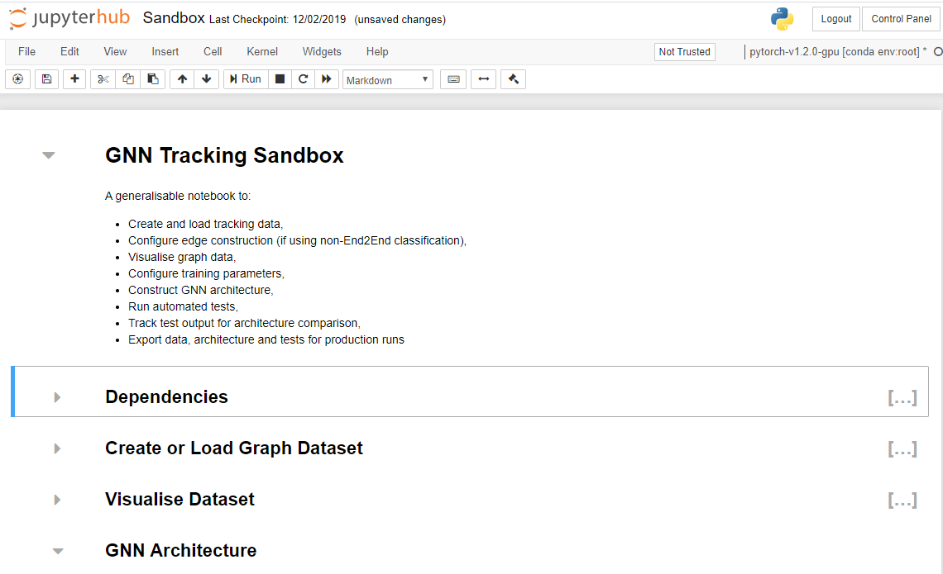
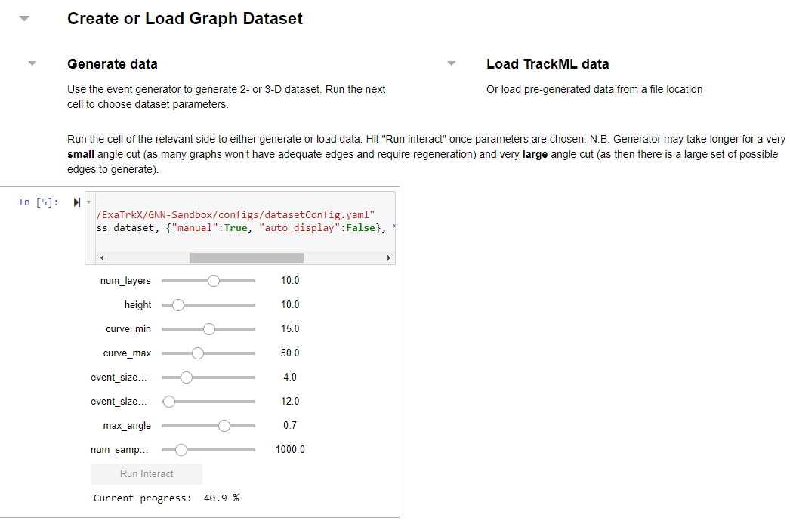
1. Generate / load data

Slide 58
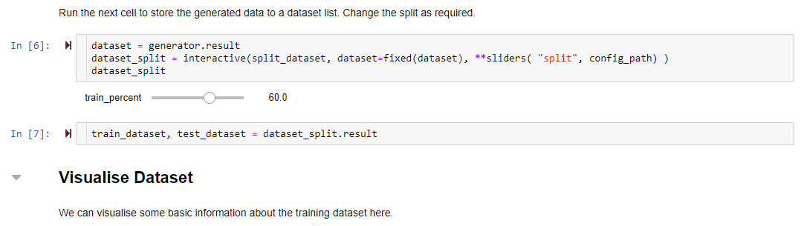
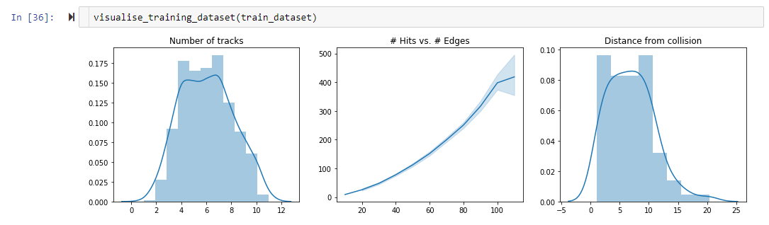
1. Generate / load data

Slide 59
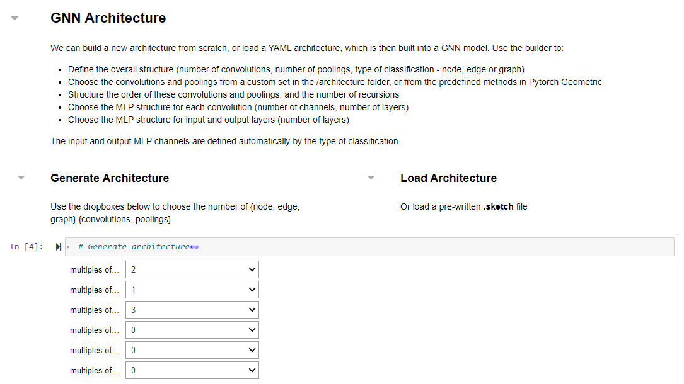
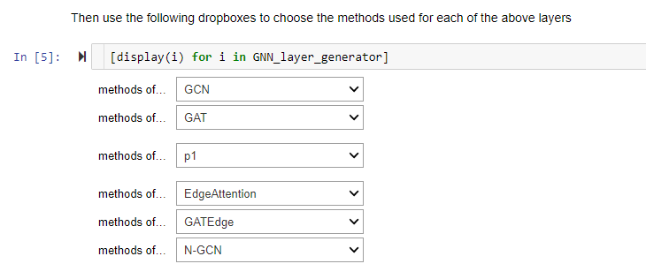
2. An attempt to generate GNN architecture

Slide 60
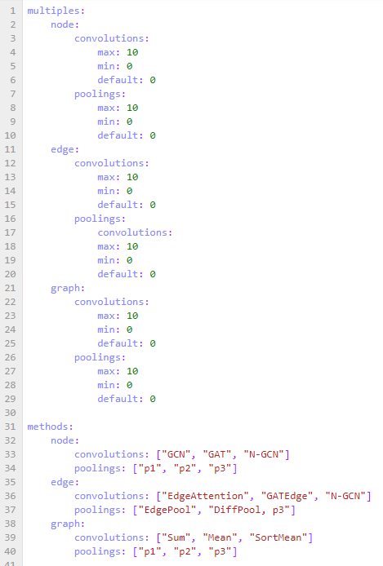
2. An attempt to generate GNN architecture
archConfig.yaml
These are
defined in
a dictionary
of methods
Method for node convolution #1
Method for node convolution #2
Method for node pooling #1
Method for edge convolution #1
Method for edge convolution #2
Method for edge convolution #3
Number of node convolutions
Number of node poolings
Number of edge convolutions
Number of edge poolings
Number of graph convolutions
Number of graph poolings

Slide 61
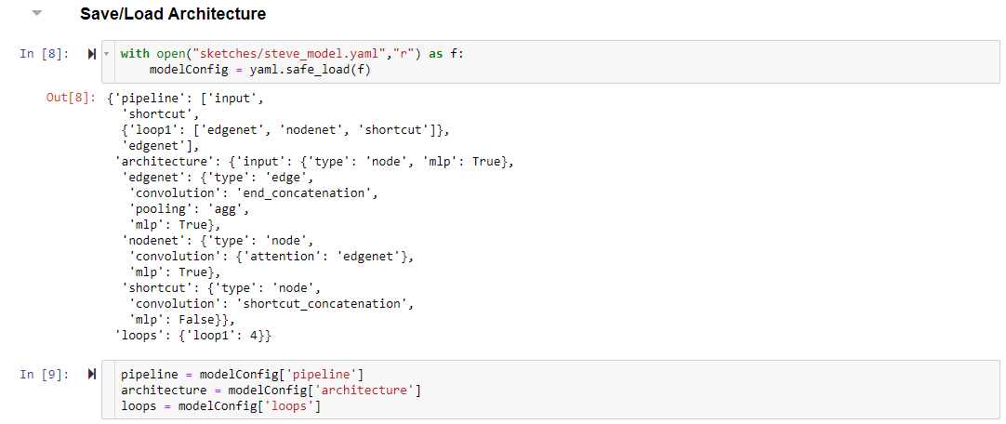
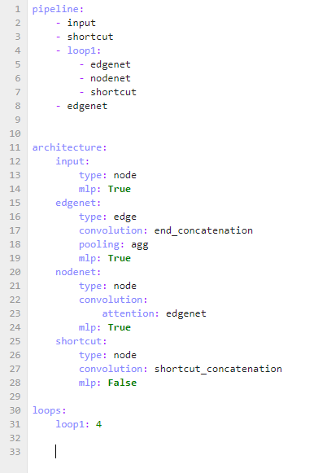
2. An attempt to generate GNN architecture
e.g. steve_model.yaml
States a pipeline
with user-defined
labels
Associates those
labels with the
dictionary of function
Handles any exceptional
behaviour (e.g. loops)
The GNN is generated from the dropdown boxes, or loaded from a “sketch” file.

Slide 62
2. An attempt to generate GNN architecture
This sucks
a bit…
e.g. steve_model.yaml
States a pipeline
with user-defined
labels
Associates those
labels with the
dictionary of function
Handles any exceptional
behaviour (e.g. loops)
These are
defined in
a dictionary
of classes
This definitely
sucks…
The GNN is generated from the dropdown boxes, or loaded from a “sketch” file.

Slide 63
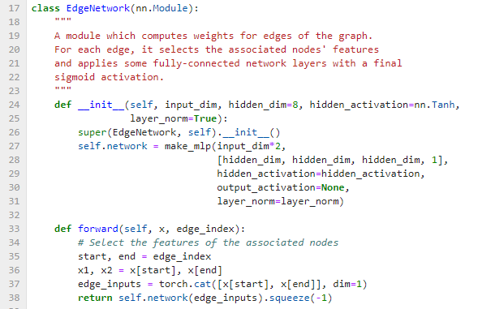
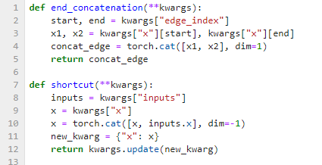
3. Train & Evaluate the model
Sketch.yaml
PyTorch Network
+
Dictionary of methods

Slide 64
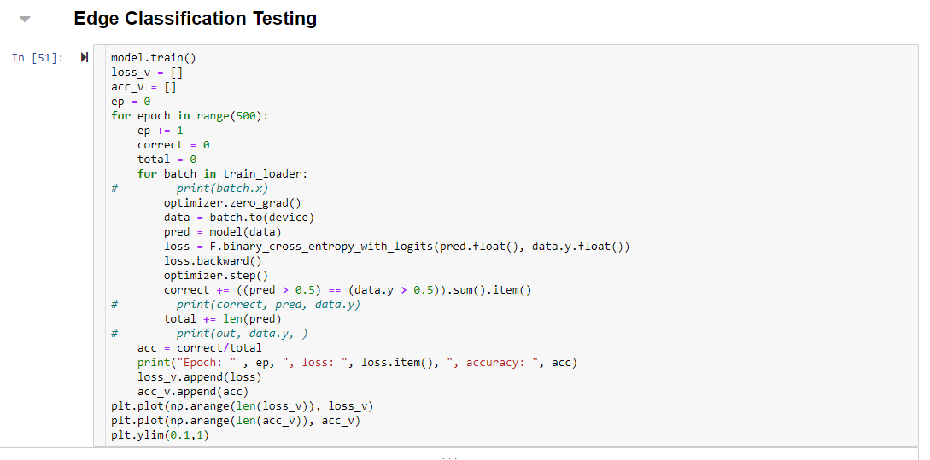
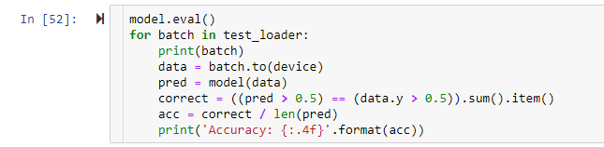
3. Train & Evaluate the model
PyTorch Training + Evaluation
PyTorch Network
Nothing special here…

Slide 65


Sandbox
DVC
ArchiOpTrX
Weights & Biases
Generate toy data / Load toy data
1
Generate a full GNN architecture
2
Train and evaluate the architecture
3
Optimise the hyperparameters
4
Compare between other architectures
5
Keep track of the hyperparameters, model architecture, weights, metrics, performance, input/output data, … everything
6

Slide 66


4. Optimise hyperparameters with Weights & Biases (W&B)
Preface with…
1.
Initialise W&B
2.
Watch model (weights & gradients)
3.
Log metrics of interest
4.
Define sweep agent
5.
Run sweep

Slide 67
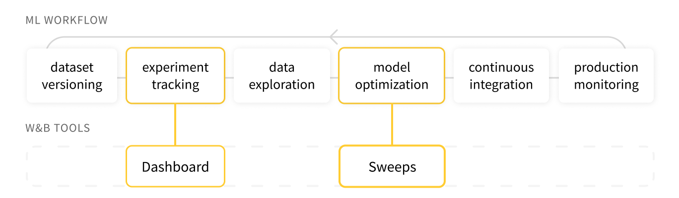
Weights & biases propaganda slide
Wandb.ai
“Those who don't track training are doomed to repeat it.”
Hard workers – have made 5 or 6 suggestions to them, and most were quickly implemented

Slide 68
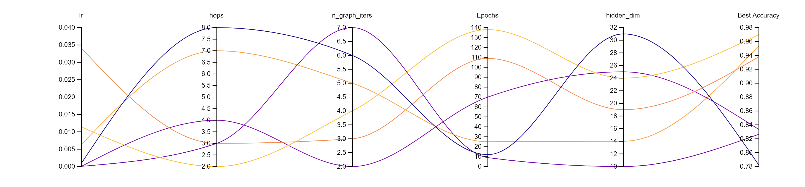
4. Optimise hyperparameters with Weights & Biases (W&B)
Sweeps compare HPO results
W&B is an amazing metric/weights/gradients tracker and visualiser, and a standard HPO platform (implements Ray’s Tune library)
An HPO sweep for
doublet classification

Slide 69
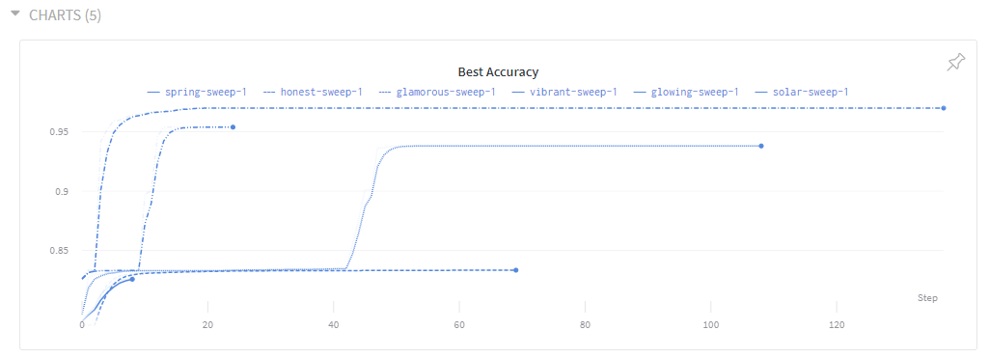
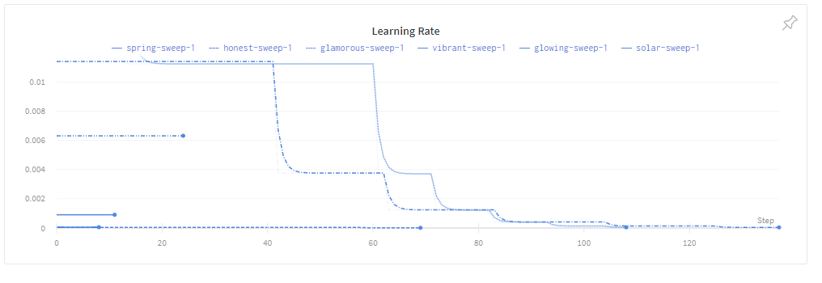
5. Compare architectures
W&B can be used to compare between sweeps
W&B can do discrete Bayesian optimisation over architectures (but this doesn’t really work well in practice)

Slide 70
Sandbox
DVC
ArchiOpTrX
Weights & Biases
Generate toy data / Load toy data
1
Generate a full GNN architecture
2
Train and evaluate the architecture
3
Optimise the hyperparameters
4
Compare between other architectures
5
Keep track of the hyperparameters, model architecture, weights, metrics, performance, input/output data, … everything
6

Slide 71
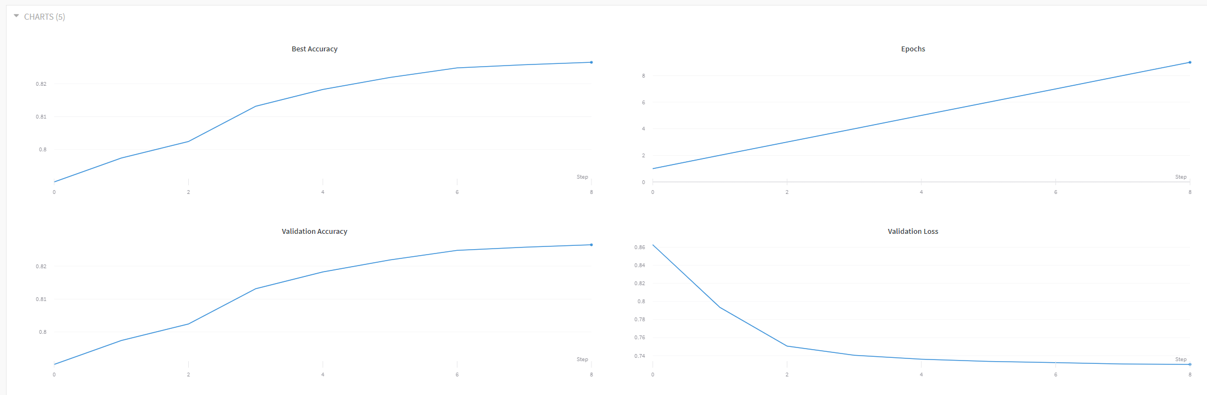
6. Track everything
W&B tracks every element of a model:
  Metrics

Slide 72
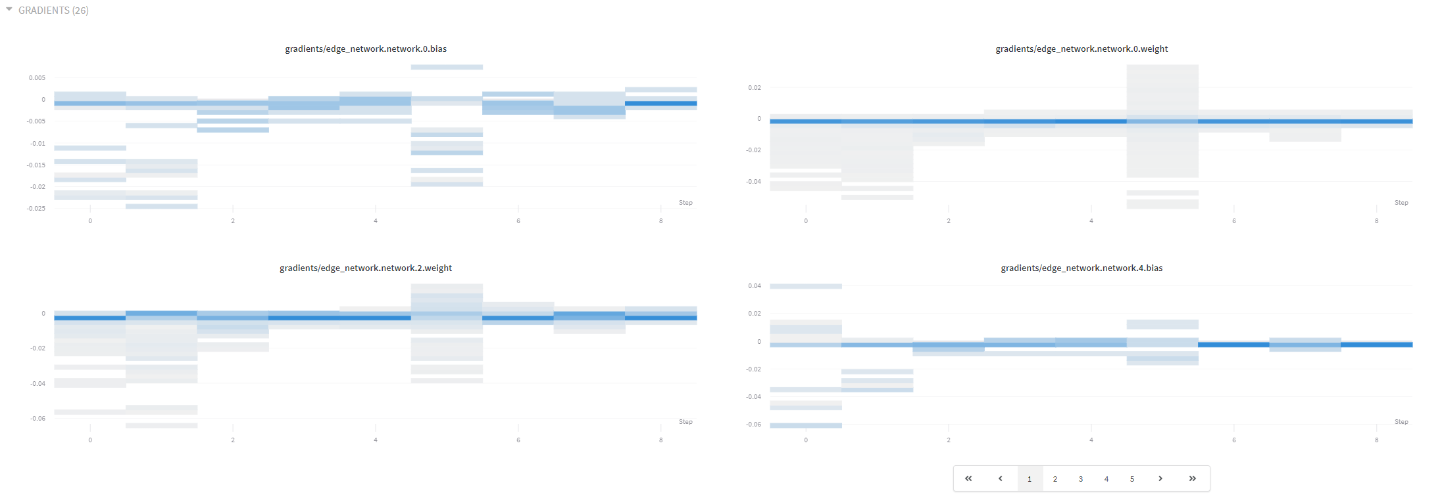
6. Track everything
W&B tracks every element of a model:
  Metrics
  Gradients + weights

Slide 73
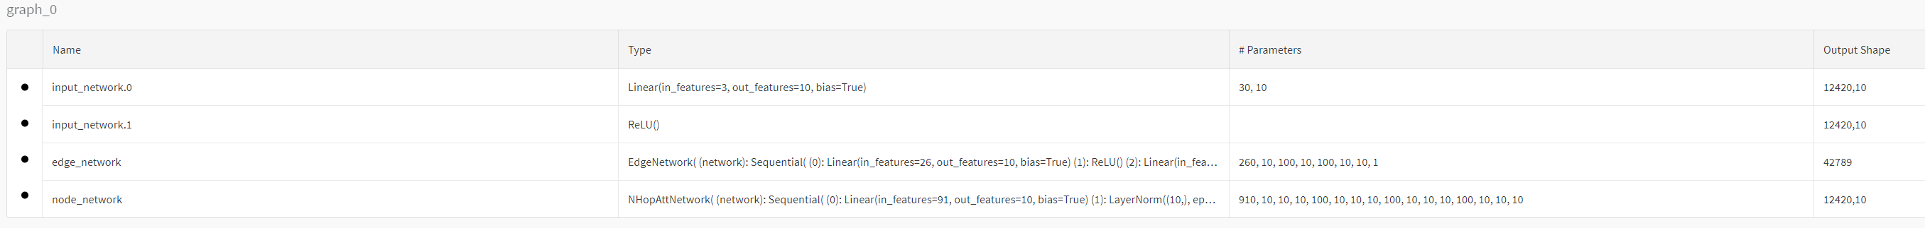
6. Track everything
W&B tracks every element of a model:
  Metrics
  Gradients + weights
  Model architecture

Slide 74
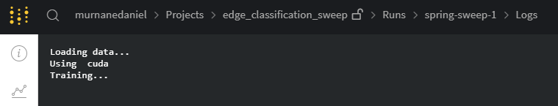
6. Track everything
W&B tracks every element of a model:
  Metrics
  Gradients + weights
  Model architecture
  Terminal logs

Slide 75
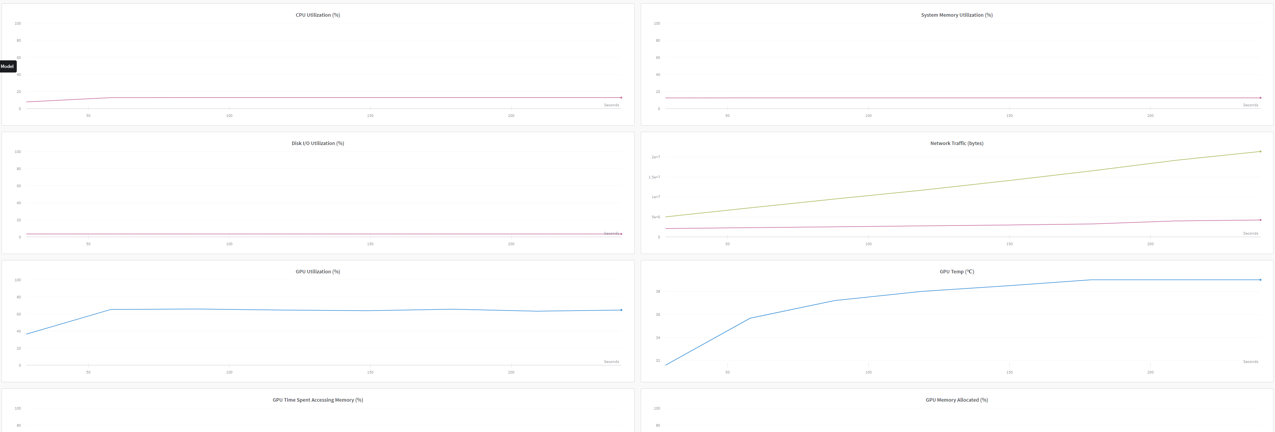
6. Track everything
W&B tracks every element of a model:
  Metrics
  Gradients + weights
  Model architecture
  Terminal logs
  Performance

Slide 76
6. Track everything
W&B tracks every element of a model:
  Metrics
  Gradients + weights
  Model architecture
  Terminal logs
  Performance
Not reproducible, per se
Need Data (and model) Version Control (DVC)

Slide 77
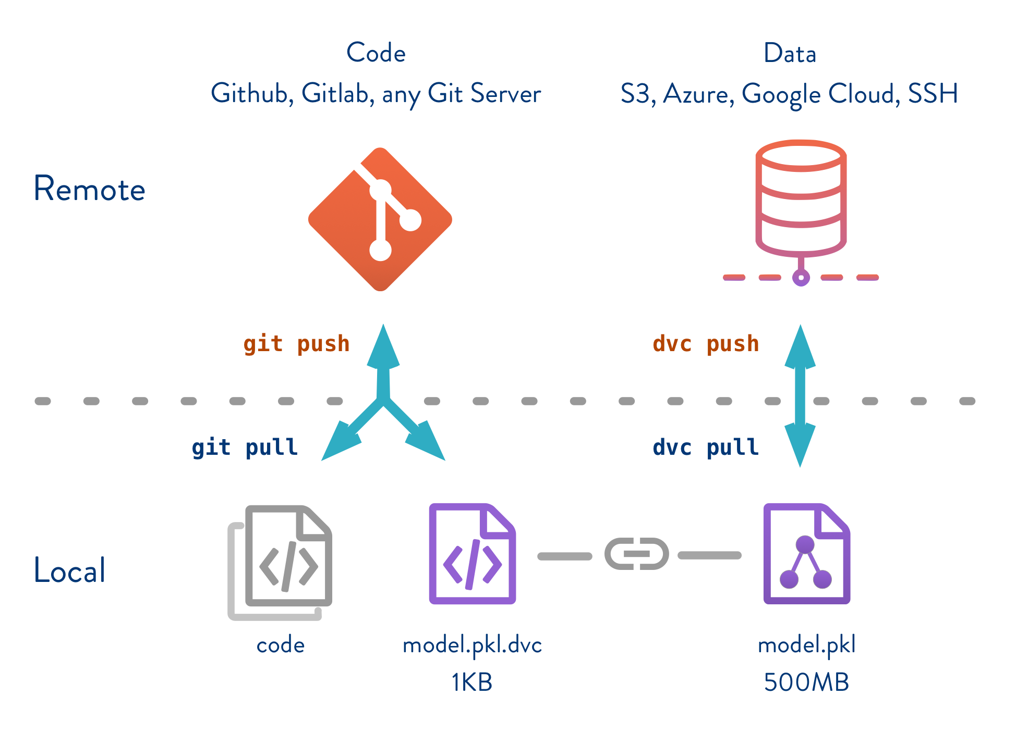
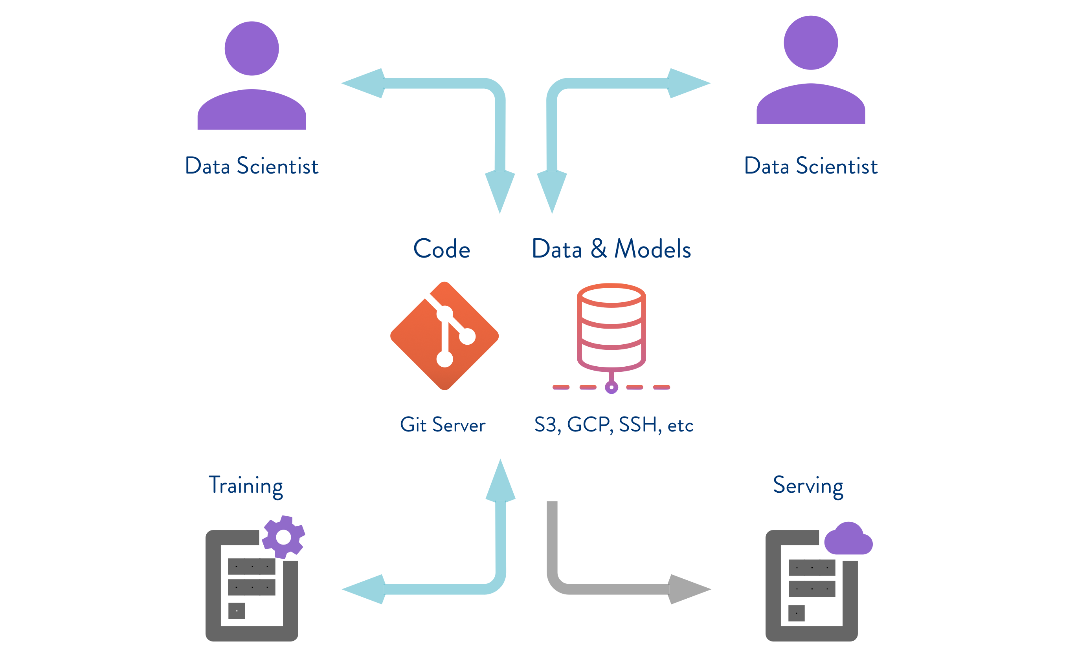
DVC propaganda slide
DVC.org
A full model & data versioning solution
Excellent tutorials
Also work very hard
Pretty reliable Google Drive API

Slide 78
Sandbox
DVC
ArchiOpTrX
Weights & Biases
Generate toy data / Load toy data
1
Generate a full GNN architecture
2
Train and evaluate the architecture
3
Optimise the hyperparameters
4
Compare between other architectures
5
Keep track of the hyperparameters, model architecture, weights, metrics, performance, input/output data, … everything
6

Slide 79
6. Track everything
dvc run:
wandb run sweep
DVC wraps W&B
git commit
dvc push
Sends all model/
pipeline info to Google Drive
Checkout with DVC, inspect in W&B
Model versions controlled and visualisable
Define architecture
Hand engineer, (or)
Naïve layer builder
W&B HPO wraps PyTorch train/eval
  Pipeline is thus:
dvc repro

Slide 80
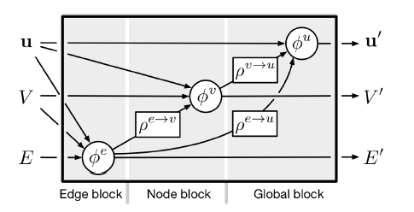
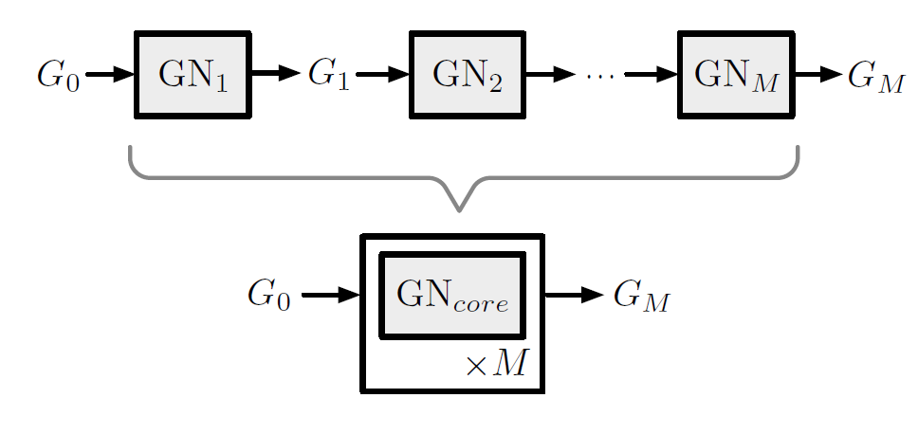
2. Generate GNN architecture
Redux: Graphs all the way down
Linear pipeline is not a good representation for a GNN
C.f. Relational Inductive Biases, Deep Learning, and Graph Networks [Battaglia et al., 2018, Google DeepMind + Brain + U of Edinburgh]
Google paper uses “blocks”, where each block contains a flow of one node, edge and graph function

Slide 81
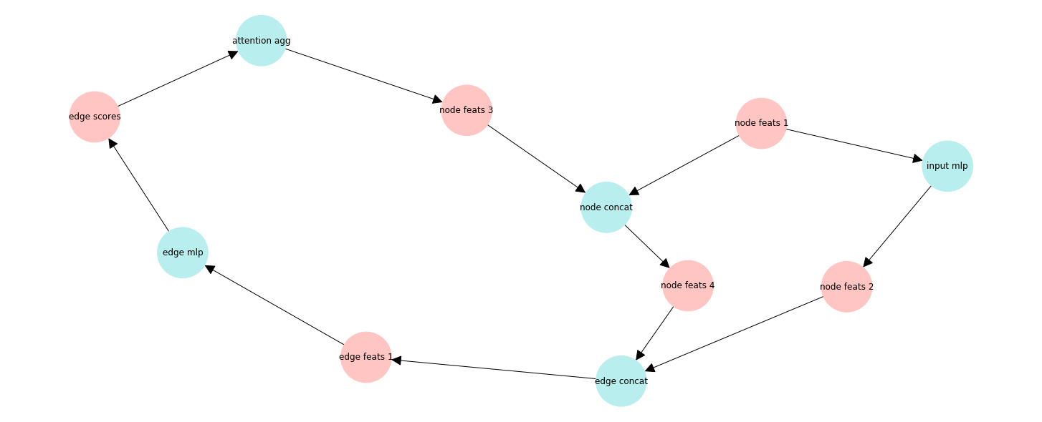
2. Generate GNN architecture
Redux: Graphs all the way down
Graph representation
ML Network as computations graph, e.g. GNN Attention Model
Neural Architecture Search Over a Graph Search Space [Jastrzebski et al., 2019, Google AI]
Suggests graph representation can be optimised better than linear representation
Linear representation
Data node
Function node

Slide 82
2. Generate GNN architecture
Redux: Graphs all the way down
Graph representation
ML Network as computations graph, e.g. GNN Attention Model
Neural Architecture Search Over a Graph Search Space [Jastrzebski et al., 2019, Google AI]
Suggests graph representation can be optimised better than linear representation
NodeNet
EdgeNet
Linear representation
Data node
Function node

Slide 83

2. Generate GNN architecture
Redux: Graphs all the way down
New plan: generate GNN architecture as a computation graph
Obvious problem: Cannot arbitrarily connect data-function-data
To choose the structure of the graph, walk through a function graph
As we walk through function graph, we are constructing the
computation graph
Example function graph

Slide 84
Architectureoptimisation(with/for)trackx: archioptrx
Define sources and targets (e.g. source: node data, target: edge data)
Start random walk in function graph at source node
From data nodes, randomly choose a child function
From function nodes, proceed to child data

Slide 85
Architectureoptimisation(with/for)trackx: archioptrx
Define sources and targets
(e.g. source: node features, target: edge features)
Start random walk in function graph at source node
From data nodes, randomly choose a child function
From function nodes, proceed to child data
function graph
X% chance of
accepting target
Node
Feats 1
Node MLP 1
Node
Feats 2
Edge Concat 1
Edge Feats 1
Edge MLP 1
Edge Feats 2
computation graph

Slide 86
Architectureoptimisation(with/for)trackx: archioptrx
First pass track (could be good enough)
Then, can add subsequent tracks with Y% percent likelihood,
randomly choosing a new source/target. E.g. recurrence:
Node
Feats 1
Node MLP 1
Node
Feats 2
Edge Concat 1
Edge Feats 1
Edge MLP 1
Edge Feats 2
function graph
Node
Feats 3
Edge Sum 1
loop
Node
Feats 1
Node MLP 1
Node
Feats 2
Edge Concat 1
Edge Feats 1
Edge MLP 1
Edge Feats 2

Slide 87
Handling multi-input functions
What happens when we reach a function that has # parents > 1
We reverse random walk – follows the exact prescription of regular walk but with source target
function graph
Node Feats 4
Node
Feats 1
Node MLP 1
Node
Feats 2
Edge Concat 1
Edge Feats 1
Edge Attention 1
Node Feats 3
computation graph

Slide 88

Archioptrx random generation works
With function graph pictured, we get with source=node, target=edge:
First pass track

Slide 89

Archioptrx random generation works
With function graph pictured, we get with source=node, target=edge:
Two track iterations

Slide 90
Archioptrx: plugging into pipeline
dvc run:
wandb run sweep
DVC wraps W&B
git commit
dvc push
Sends all model/
pipeline info to Google Drive
Checkout with DVC, inspect in W&B
Model versions controlled and visualisable
Architecture generation
Function graph random walk
W&B HPO wraps PyTorch train/eval
Generate hyperpar-ameters
Given the full archit-ecture
dvc repro

Slide 91
Next Step
RNN Reinforcement Learning controller for function graph walk

Slide 92
Backup

Slide 93


Aside: quick notation
Recall $≡$ Efficiency
Precision $≡$ Purity

